Slide 1
Anxiety
Tips to support your child

Slide 2
What is Anxiety?
Normal emotion- everyone feels it sometimes. It can be helpful as it protects us from danger and help us prepare for things
For some- can impact daily life by making it difficult to do certain things
Can affect different aspects of a person’s life:
  School and hobbies
  Friendships/ family relationships
  Sleep
  Emotions

Slide 3
Common symptoms of Anxiety
Muscle aches
Dizziness
Headaches
Feeling overwhelmed/full of dread
Difficulty concentrating
Feeling irritable
Dry mouth
Sweating
Frustration
Pins and needles
Nervousness
Feeling sick
Irregular heartbeat
Trembling
Feeling restless
Feeling scared
Panicky
Stomach-ache
Feeling frightened

Slide 4
Reasons why a Child might be Anxious
Friendship issues
Illness
School life (homework, peer pressure, self-confidence)
Specific fear
Changes to routine
Hormones
Lack of sleep
Family issues (divorce, grief and loss, parental health/mental health)

Slide 5
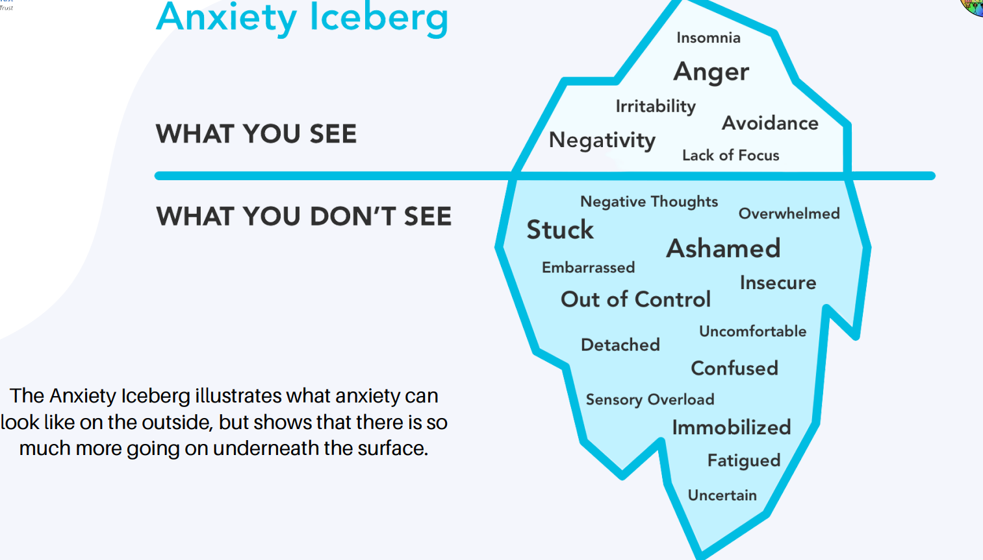

Slide 6
Flight, flight, freeze
Humans developed the fight, flight, freeze automatic response as cave men as it was a much more dangerous time to live back then
The fight, flight, freeze response meant that cave men's bodies went into survival mode whenever their brains sensed danger. This meant their heart rate and blood pressure would increase so they had a better chance of running away or fighting the danger.
Even though we don't face the same dangers today, our brains and bodies still react in the same way to the things we perceive as dangerous, scary or worrying. This means our increased heart rate and blood pressure causes us to feel anxious.

Slide 7
Types of Anxiety
Generalised Anxiety
Phobia
Panic
Separation Anxiety
Social Anxiety

Slide 8
Negative Automatic Thoughts
The average person has over 60,000 thoughts in a day
Negative Automatic Thoughts (NATs) come when they want to, without choice and they can be difficult to stop. They present themselves as facts and children often believe them.
It is important to remind your child that thoughts are NOT facts and they can learn how to change them. It is really important to be able to spot NATs so they can challenge them.

Slide 9
How to Help
Talk to your them
Actively listen
Encourage them to write/draw their thoughts
Use of relaxation/grounding techniques

Slide 10
How to talk to your child about mental health
Be receptive:
  You look sad/upset today, do you want to have a chat/is their anything I can do?
  I've got time to talk / would you like to go for a walk?
  I noticed you seemed upset yesterday. I wanted to talk to you when we were alone. I'm really concerned about how you're doing.
Use open questions:
  I care about you and I've noticed you haven't been yourself lately. You seem more frustrated than you've been in a while, and I’m wondering how you're doing?
  Tell me more, how did that make you feel?

Slide 11
It is unhelpful to..
Pressure your child to 'snap out of it' , 'get their act together' or 'cheer up’.
Tell them how lucky they are and they should be happy and grateful for what they have.
Tell them that you have real worries and dismiss theirs.
Stay away or avoid them.
Assume the problem will go away and ignore it.

Slide 12
Active Listening
Listen to what your child has to say without interrupting.
Be open-minded and non-judgemental.
Be patient - don't rush them or fill the gaps unnecessarily.
Avoid telling them what to do.
Remove distractions - phones, TV etc.

Slide 13
Managing Anxiety
Encouraging your child to write down their worries / anxious thoughts using a worry diary, worry box or container can help them to:
  Have a physical way of 'getting rid' of their worries so they don't need to carry them around.
  Create a routine for sorting out their worries and sharing them.
  Help your child to understand their thoughts and know that it is possible to let them go.

Slide 14
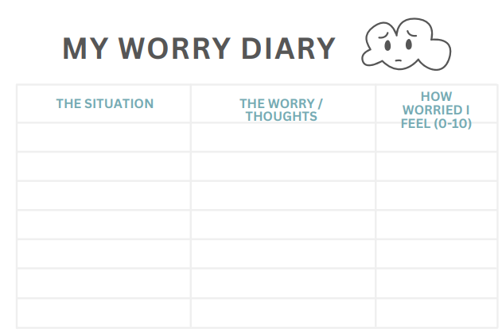
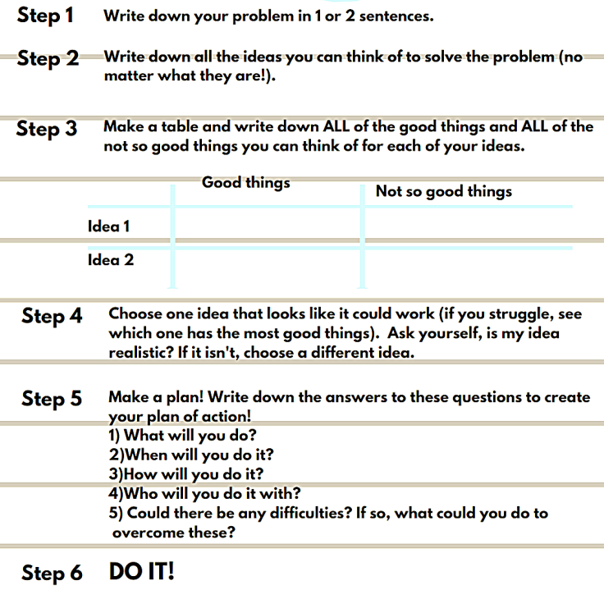
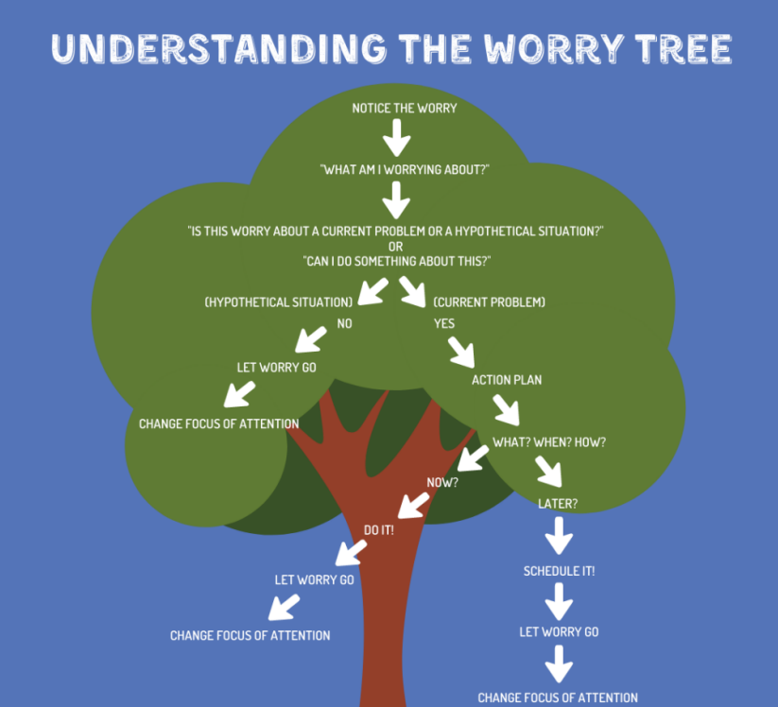

Slide 15
Breathing Techniques
Finger breathing:
Use your index finger to trace around the edges of fingers on your opposite hand.
Count 1,2,3,4 and breath in as you go up the first finger.
Count 1,2,3,4 and breath out as you go down the finger.
Repeat until you have traced up and down all five fingers breathing in 1,2,3,4 and breathing out 1,2,3,4 each time.
Square breathing:
Imagine you are drawing a square with your finger in the air.
Breathe in whilst counting 1,2,3,4 as you draw the top line and then pause.
Breathe out whilst counting 1,2,3,4 as you draw the line down the side and then pause.
Belly breathing:
Take a deep breath in and fill your belly like you're inflating a balloon.
As you do this, count 1, 2, 3, 4 to breath in and fill the balloon in your belly.
Pause and then let all of the air out of your belly like you're letting a balloon deflate.
As you do this, count 1, 2, 3, 4 to breath out and let the balloon go down from your belly.

Slide 16
Calming Techniques
Stating Facts
  Think about and name facts about what is going on right now. For example, think: My age is... My name is... I am wearing... The weather is...
Search the Room:
  Think of a category and search the room for it. For example, look for: Everything that is a ... colour, Things made of …
5, 4, 3, 2, 1:
  Take notice of your senses by thinking of: 5 things you can see, 4 things you can hear, 3 things you can feel/touch, 2 things you can smell, 1 thing you can taste.

Slide 17
Additional Support
Young Minds
Shout 85258
The Sandbox
CAMHS

