Slide 1
Mental Health
SEN Coffee Morning
12/12/25

Slide 2
“Mental health influences how we think and feel about ourselves and others and how we interpret events. It affects our capacity to learn, to communicate and to form, sustain and end relationships. It also influences our ability to cope with change, transition and life events: having a baby, moving house, experiencing bereavement.”
-Dr Lynne Friedli

Slide 3
Mental Health Statistics
10% of children 5-16 suffer from a diagnosable mental health disorder
35% of young adults don’t seek help- primarily because of stigma
44% of adults claiming disability allowance have a mental health need
Among teenagers, rate of depression and anxiety have increased by 70% in 25 years
½ to ¼ of children in each class struggle with EBSA

Slide 4

Stress Bullseye
We can’t do anything about it
(acceptance)
Time dependant; something to deal with in the near future
(write it down)
We can do something about this now (planning)

Slide 5
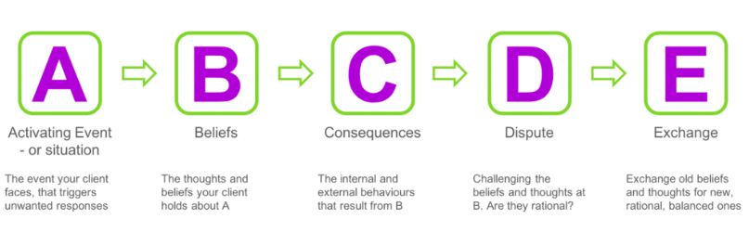
The ABC Model, Albert Ellis

Slide 6
The ABC Model
What really makes us feel the way we do, is not the situation or the words and actions of another person, but our thoughts and beliefs in response to that situation or person
When a person experiences a negative or distressing emotion, this is usually because they have been thinking negative thoughts
These negative thoughts are also called unhelpful thoughts because they lead to unpleasant feelings or unhelpful actions
To begin to influence and change the way you feel, you need to be aware of your unhelpful thoughts

Slide 7
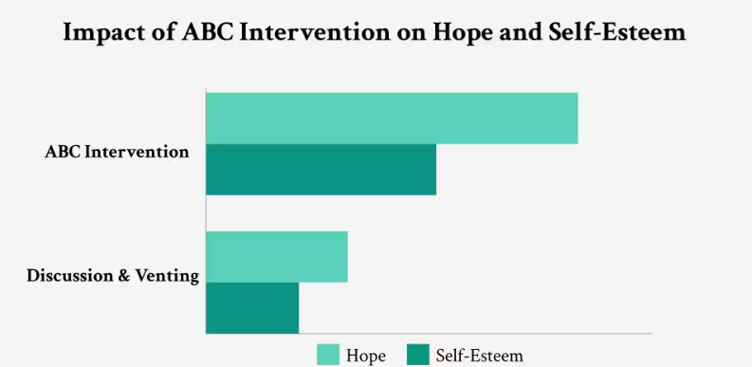
Case study, Sælid and Nordahl (2017)

Slide 8
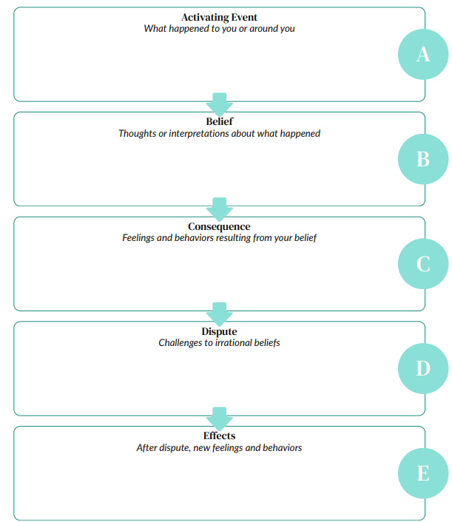
Is this belief based on facts?
Are there other ways to view the situation?
What would I tell a friend in this situation?
“I did my best, and that’s good enough”
“Mistakes are opportunities to learn and grow”
“I can work hard and try again.”

Slide 9
Helpful Resources
https://signpostcounselling.org.uk/
https://www.hertsmindnetwork.org/
https://www.hct.nhs.uk/service-details/service/childrens-wellbeing-practitioners-21/
https://www.withyouth.org/
https://luminova.app/
https://www.add-vance.org/parents/neurodiversity-support-hub/
https://www.youngminds.org.uk/parent/parents-helpline/
https://thesandbox.mindler.co.uk/

Slide 10
Helpful Resources
Think Good, Feel Good by Paul Stallard
Charlie Changes into a Chicken by Sam Copeland
No Worries! Mindful Kids by Lily Murray
Big Bright Feelings books by Tom Percival
The Way I Feel by Janan Cain

Slide 11
Helpful Resources
School Nursing Service (self referral)
Children’s Wellbeing Practitioners (self referral)
CAMHS Step 2 (self referral for mental health)
The Butterfly Room (private therapy)
NESSIE (self referral)
PALMS (school or GP referral)

